Slide 1

Improving Host Quality
Presented by Andrew Early, Constance McCarney, Jessica Whalen, Kyle Riener, and Sowmya Murali

Slide 2
What We’re Solving For
How can Airbnb ensure their hosts are the cream of the crop?
Our Goal: Help Airbnb improve the quality of their listings through a tool that leverages text analytics measuring whether hosts improved or declined in their reviews overtime.
Potential Resulting Action: If a host with initially low reviews has further declining reviews, Airbnb can choose to deactivate the host.
Notes:
Looking at the key topics and positive/negative reviews for specific listings with the goal of understanding how these change overtime (1) overall sentiment (customer satisfaction which is one of the most important things to consider in maintaining a business, both for AirBnB and owner), (2) specific topics contributing to positive and negative . want to understand to help the host to improve their listings and for potential airbnb guests to factor into their decision to stay.
We have :
Sentiment score
Template code
We need:
organize

Slide 3
Our Process
Explore dataset
Generate sentiment scores for each review
Subset reviews by good and bad based on sentiment scores
Create document term matrix, LDA and word clouds
Deep dive into specific listing to see change in sentiment over time
Topic analysis of reviews
End Goal: Each host will have a chart of the trend of their sentiment scores and areas of improvement.

Slide 4
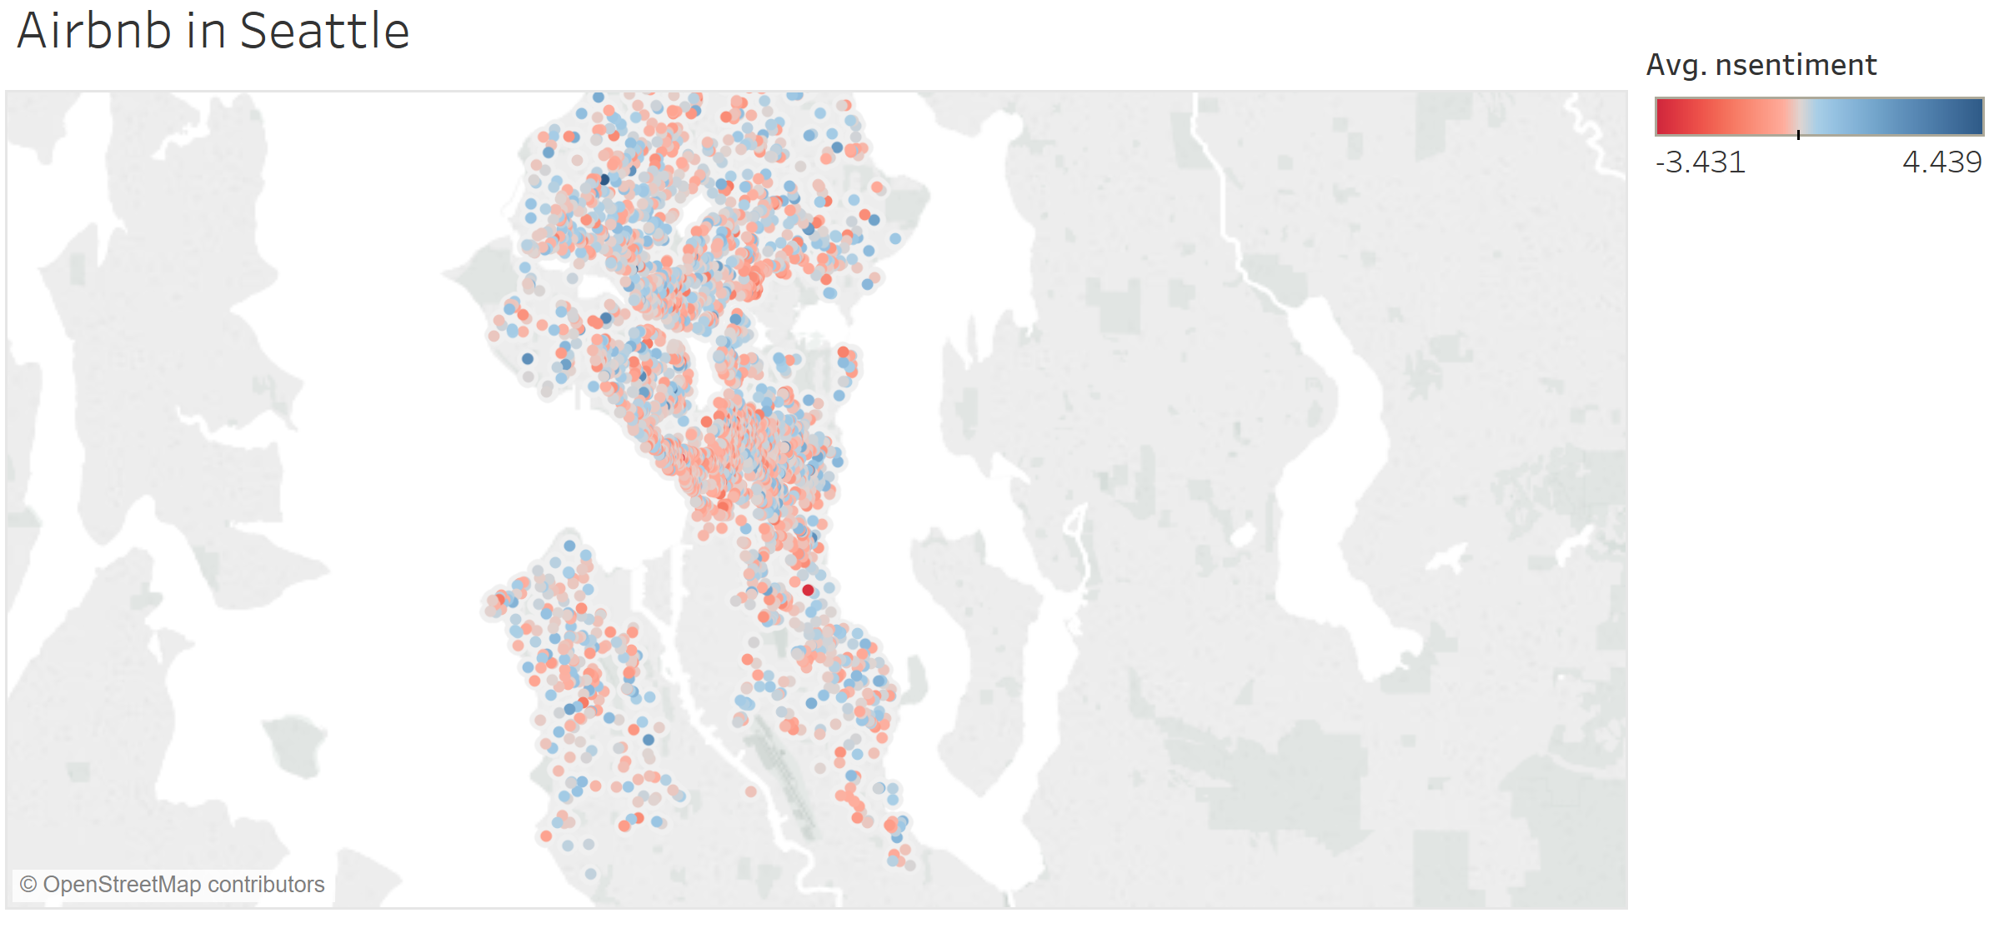
Insights: Seattle Sentiments Map
Ballard
University District
Magnolia
Queen Anne
Capitol Hill
Downtown
Notes:
We should mention that these are normalized sentiment scores
University District has the most negative scores
Magnolia has the most positive score
library(psych)
df4describe= subset(listings4reg_complete, select= c(neighbourhood_group_cleansed,sentiment,price,review_scores_rating,accommodates))
describeBy(df4describe,df4describe$neighbourhood_group_cleansed)

Slide 5
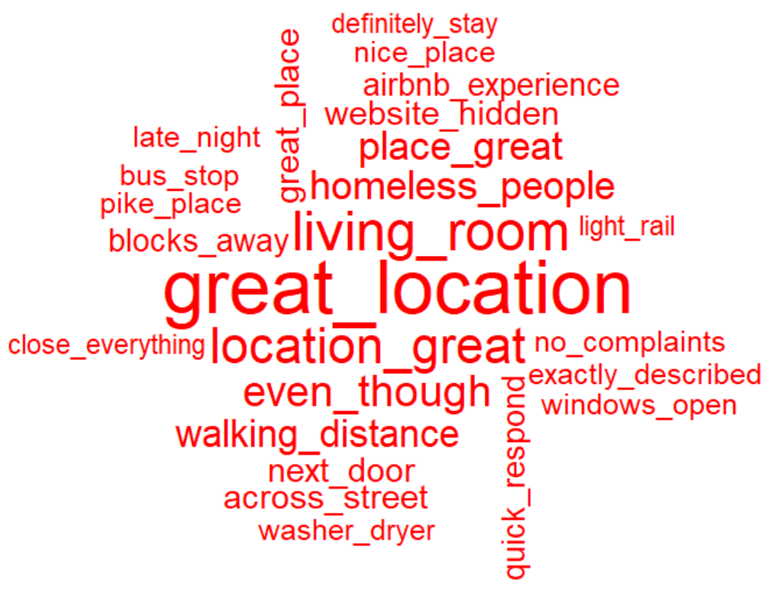
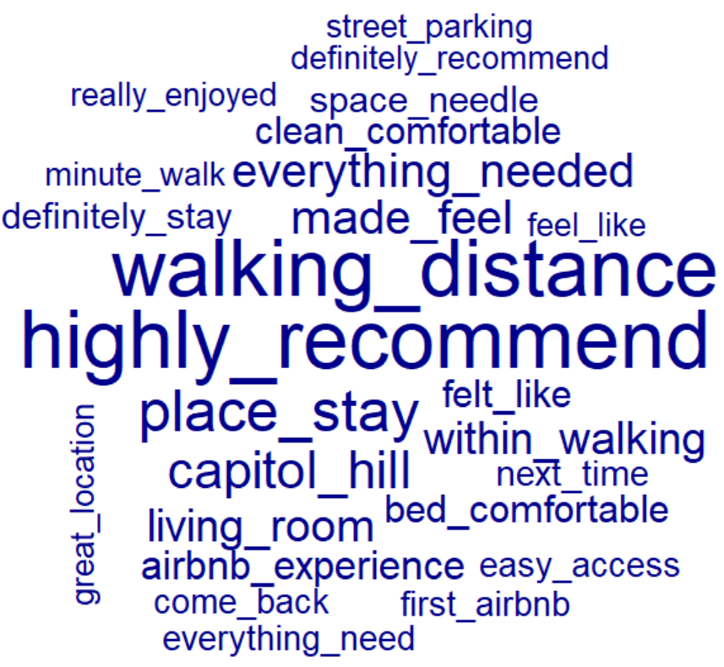
Insights: The Bad vs. Good
….Or Not!
Notes:
Customers generally read through comments despite 5 star reviews (don’t blindly book) - therefore what’s more important than the rating is the comment left by the guest
Basically, not that much difference between good and bad, the ‘even though’ and ‘but’ and ‘however’ are the key issues. People typically had good times with one off complaints so we had to normalize the sentiment scores to get a better range

Slide 6
Compliment Sandwich
“My parents stayed in Amy and Spanish apartment for 6 days while visiting us. The place is mostly as advertised. The view from the top floor is spectacular. Amy and Sean are responsive and friendly. The bed is comfortable. Unfortunately the apartment is a bit rundown. And if you're a clean freak it's probably not for you...”
“It was a very nifty spot with great location... But during the stay I was unaware that I would be sharing the space and tub with another person as they didn't know either so the showering situation was weird as it's only a curtain separating the room and also would have to come into my space to go to the toilet...”
“Check in was smooth. The place was as described. However, the wifi was so slow it was almost non functional. Also, the cable line up was limited (no ESPN). One day an unknown man came in to the downstairs part of the building and plugged in a battery to charge. He had the code to the lock and full access to the room. This was alarming because we were away from the room during the day and left our things there. It definitely raised some safety concerns. Location is good.”

Slide 7
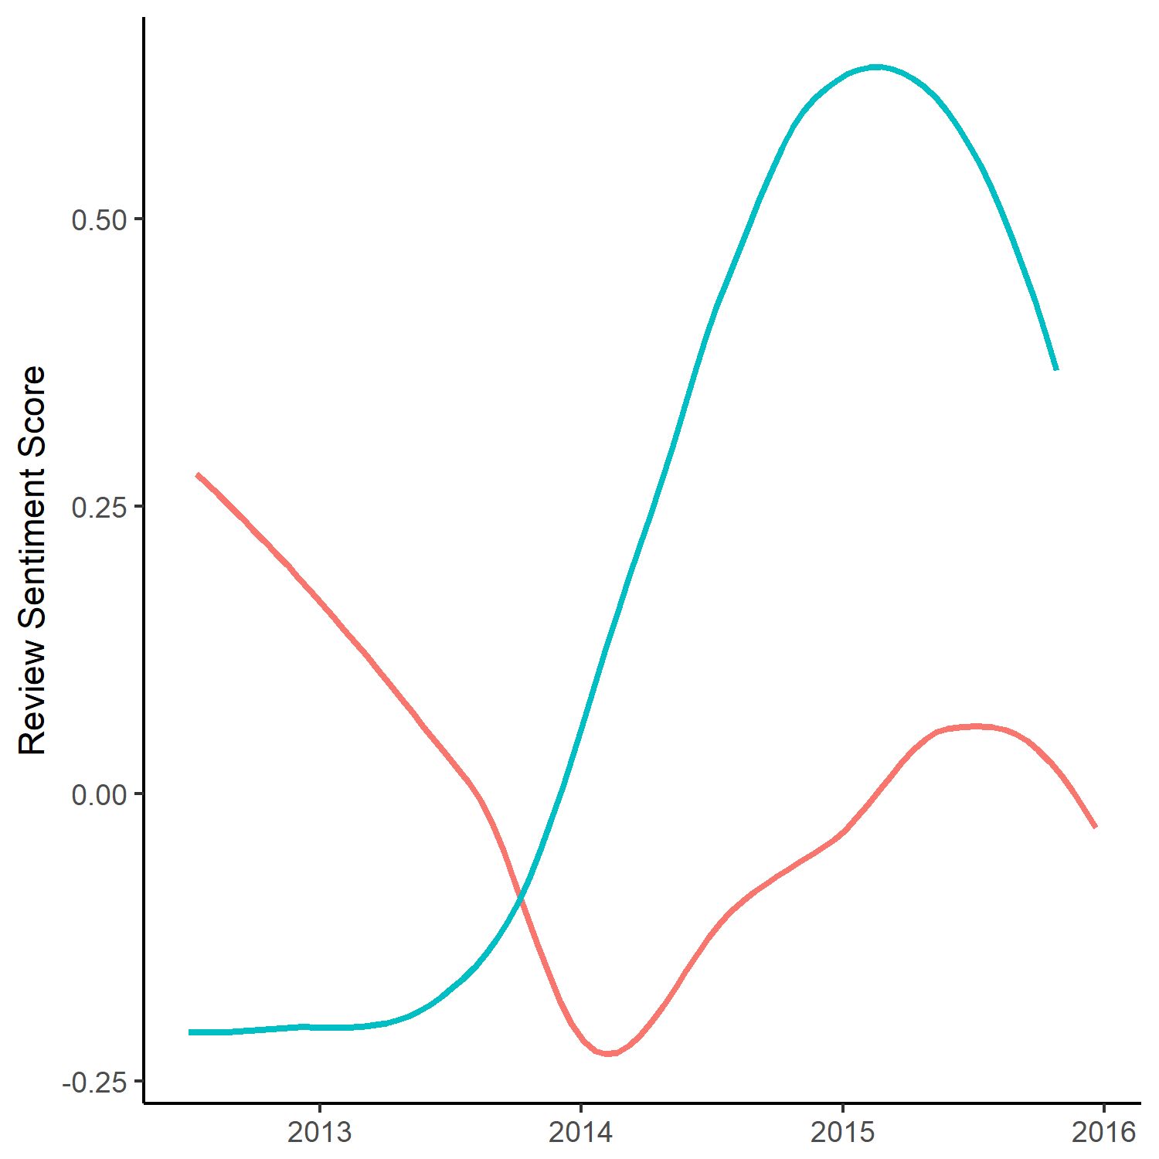
Case Study: Sentiment Score Overtime
The blue listing slowly trends upwards and declines in 2015 while the red listing initially is almost linear and trends down until 2014.
What can we do with this?
View topics used during a particular period of time
Verify if host has acted on the reviews (made changes)
Compare host to average hosts in the area

Slide 8
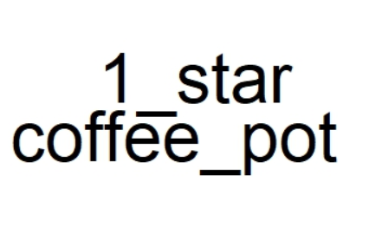
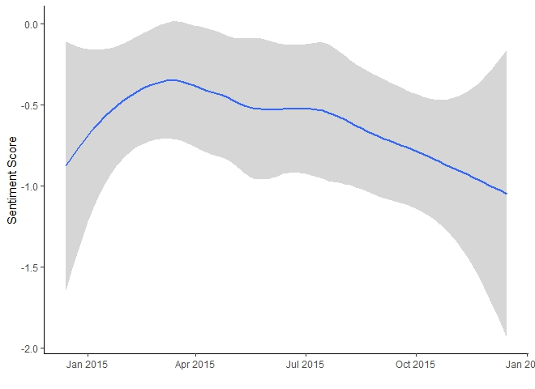
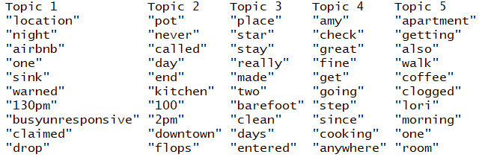
Case study - “Declining” example
Notes:
Listing ID: 4264056 (had 65 reviews over a 1yr period so this could be a good way to check in and show a host their stats and what reviewers are talking about. Apparently, this host does not have the coffee situation figured out, which we all know is crucially important to most people’s mornings! Also seems to not be responsive, which is a huge flag for customer service. (I figured for our case study we just need to show application and this would be sufficient.)
AirBnb would want to notify this host that their reviews are declining in order to ensure cream of the crop hosts.

Slide 9
Applications
Consistently provide metrics on sentiment scores and topics
Alert host if reviews decline more than 10% year-to-year
Generate unique list of areas of focus for hosts with declining reviews
Create hypercare program for “at risk” hosts

Slide 10
Limitations
Expand to cities across the world
No access to real review scores
No data on reviewer (i.e. poorly reviewed guest)
Human tendency to “soften the blow” of a bad review
Average listing scores for cleanliness/location skewed positive
Missing values in data

Slide 11
Questions?

Slide 12
Appendix

Slide 13
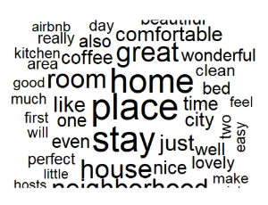
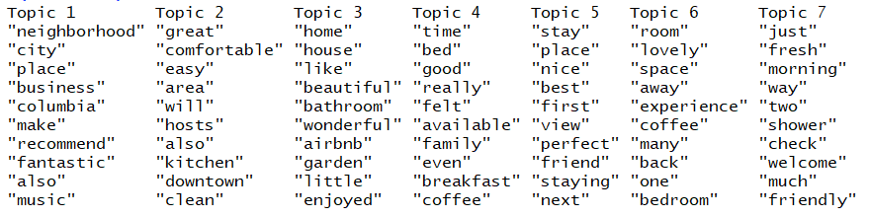
Topic analysis Positive
Notes:
This is taking the top 25% of sentiment scored reviews so gives an overall picture of things most highly values by customers.

Slide 14
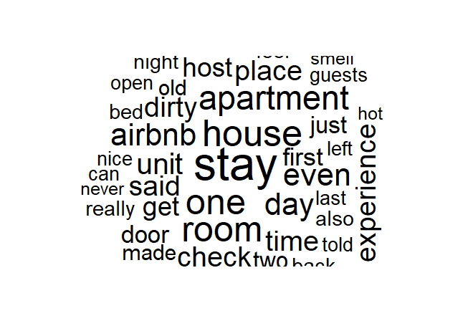
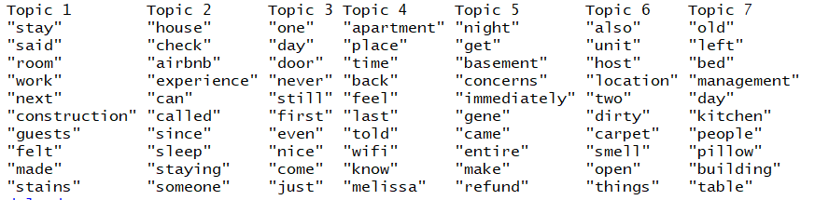
Topics Analysis
Negative
Notes:
These are overall comments from guests who had the bottom 25% of sentiment score review ratings. This could be insightful for all airbnb owners to know what is being commented on to be sure to avoid bad reviews.

Slide 15
Our Data
Number of Listings: 3,818
Reviews Data Variables
Ids: Review Id, Listing Id, Reviewer Id
Date
Name
Comments
Majority of listings had some missing values

Slide 16
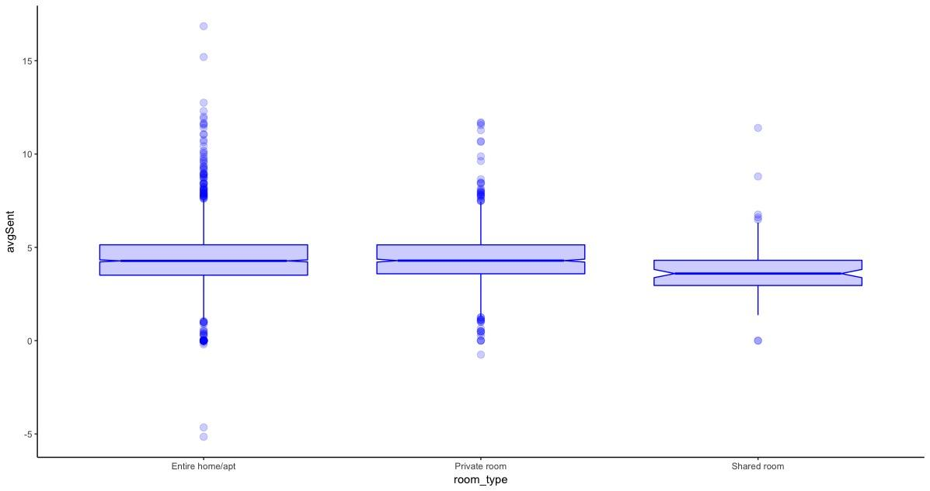
Data Exploration: Average Sentiment Score by Room Type

Slide 17
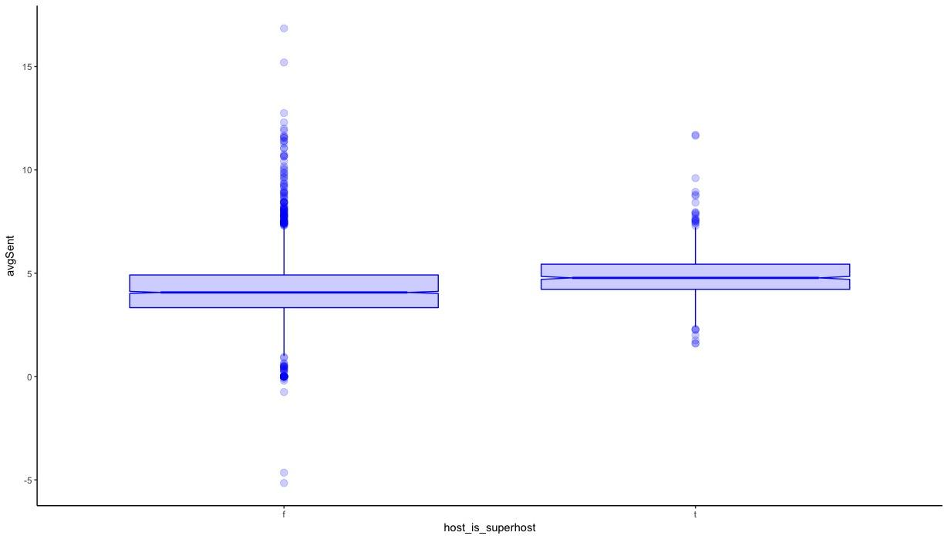
Data Exploration: Average Sentiment for Super Hosts

Slide 18
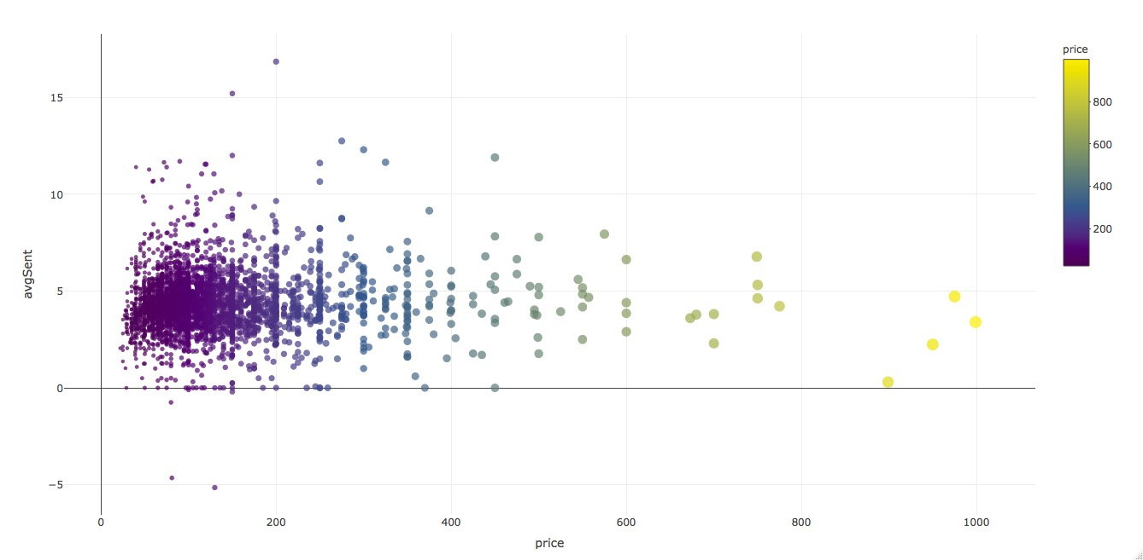
Data Exploration: Average Sentiment Score by Price

Slide 19
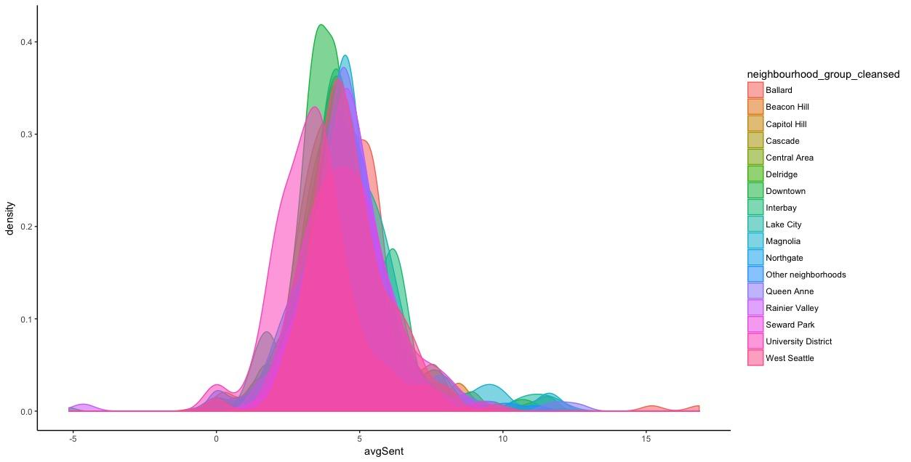
Data Exploration: Average Sentiment by Location

Slide 20
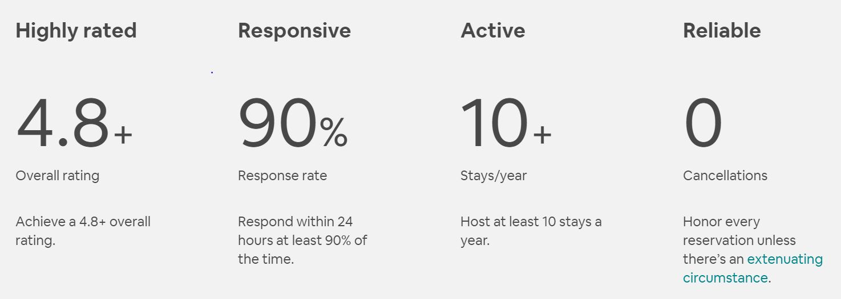
Superhost

Slide 21
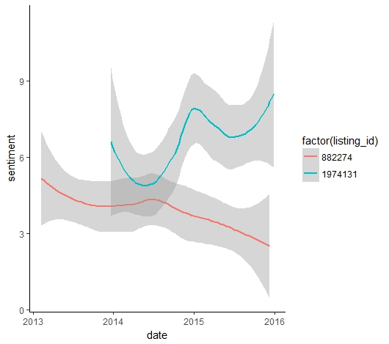
Case Study : Sentiment Score Overtime
These two listing display opposing trends.
The blue listing slowly trends upwards while the red line is almost linear and trends down.
What do we do with this?
Compare language used before and after decline to narrow down focus for improvement
Verify if host has acted on the reviews (made changes)

